Slide 1
Tablet Compatibility Screen shots

Slide 2
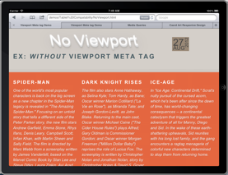
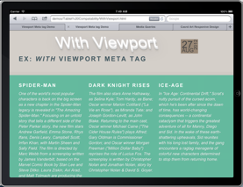
Viewport: Landscape Mode
Landscape mode, the view appears normal.

Slide 3
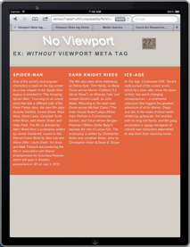
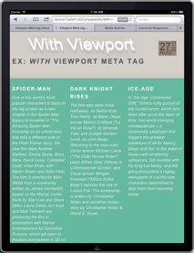
Viewport: Portrait Mode
Portrait mode, the view appears distorted. Closer together and not occupying the viewport.

Slide 4
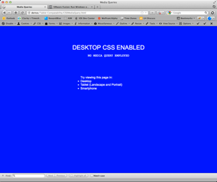
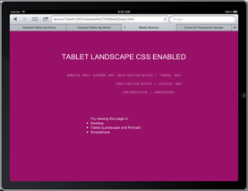
Media Queries
Media Queries support for devices and varying modes. Desktop and Tablet Landscape are rendered.

Slide 5
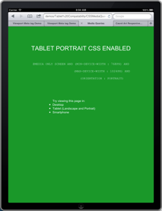
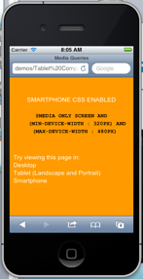
Media Queries: cont.
. Tablet & iPhone portrait modes are rendered.

Slide 6
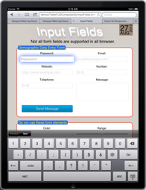
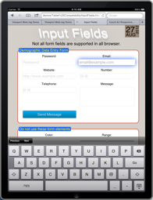
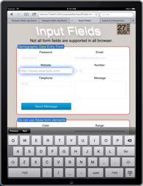
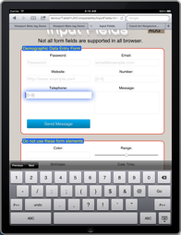
Input Fields
Input fields types and patterns can allow for the right keyboard on the right field.

Slide 7
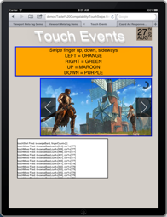
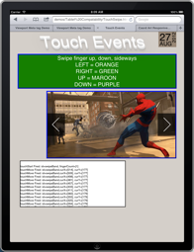
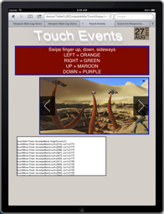
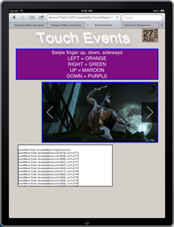
Touch Events
Touch events are executed on the color boxes and the carousel of images.

Slide 8
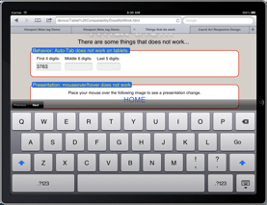
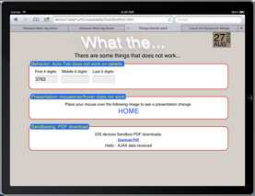
What does not work.
Auto Tabbing fails

Slide 9
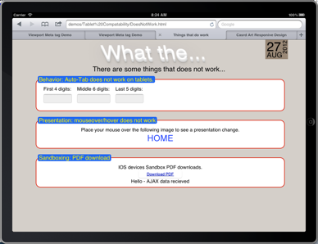
What does not work. Cont.
Mouse Event such as hover, mouseover, mouseout fail as there is no mouse

Slide 10
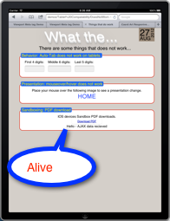
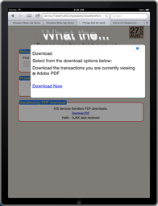
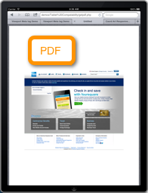
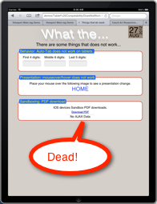
What does not work. Cont.
PDF Sandboxing on Dynamic Pages, kills/disables the viewable tab after the PDF is downloaded

